Slide 1
IT2402-Free and Open Source Software Solutions
INTRODUCTION TO LINUX

Slide 2
Before Linux
Microsoft’s DOS ,Apple MAC and UNIX were used for PCs
These operating systems were more expensive
Were proprietary; closed source
Licensing fees were high

Slide 3
UNIX
Multitasking and multiuser operating system
Developed at AT&T Bell Labs in the 1960’s
Command Line Interpreter
GUIs are now available
Used for servers/desktops/laptops
Popular varieties of UNIX
Sun Solaris
BSD
GNU/Linux
MacOS X.

Slide 4
BSD
The Berkeley Software Distribution
Variant of Unix
When UNIX was commercialized, “Net 2 BSD” was available under a permissive license
BSD license did not force to share the source code publicly for derived works

Slide 5
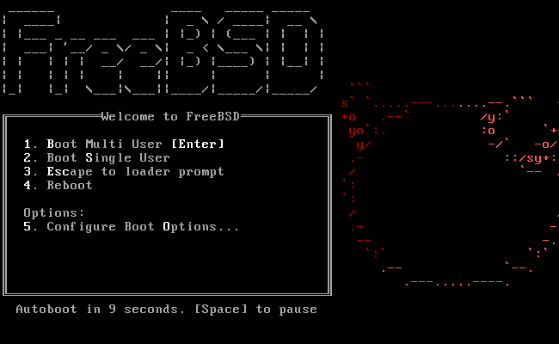

Slide 6

GNU
The name “GNU” is a recursive acronym for “GNU's Not Unix.
Launched by Richard Stallman in 1983
An operating system
100% free software
No stable release

Slide 7
Linux
Just a Kernel
Started by Linus Torvalds developing a free UNIX kernel
The successor of UNIX
Open source
Linux distributions create a complete Linux OS

Slide 8
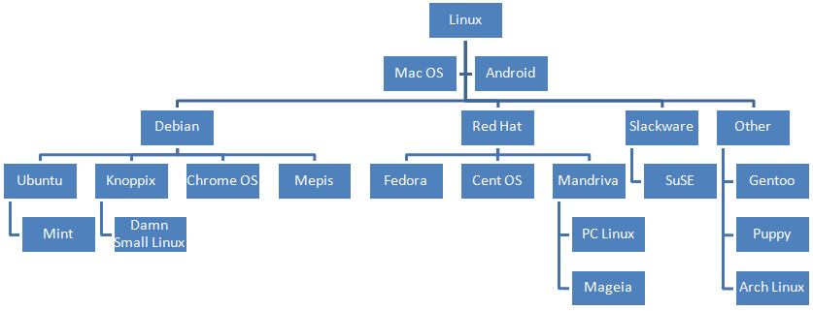
Linux Distributions (distros)

Slide 9
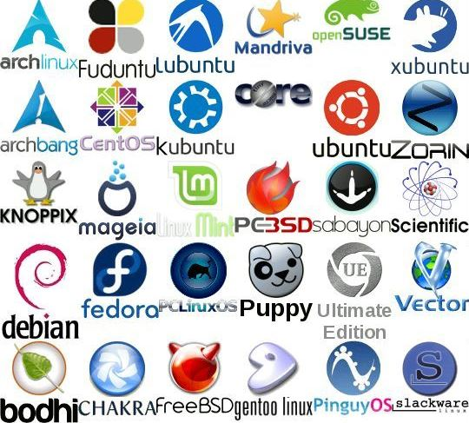

Slide 10
Features of Linux
Multiuser
Open source
Inexpensive
Multitasking
Security
Network friendly

Slide 11
Linux Advantages
Protected from Virus attacks
More stable
Better security
Free and open source

